Slide 1

Excited States and Nonadiabatic Dynamics
CyberTraining School/Workshop 2023
Alexey Akimov
University at Buffalo, SUNY
June 12, 2023

Slide 2
Libra overview

Slide 3


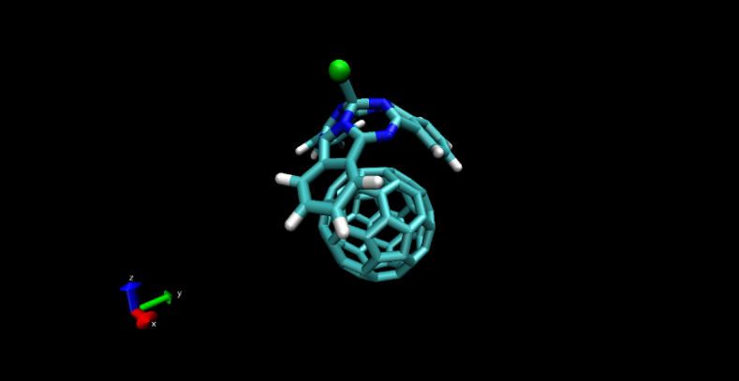
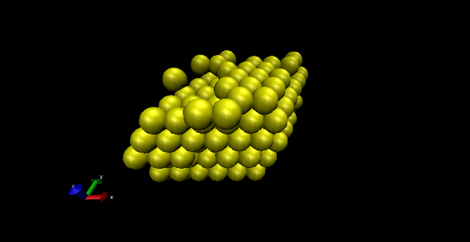
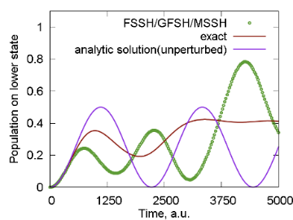
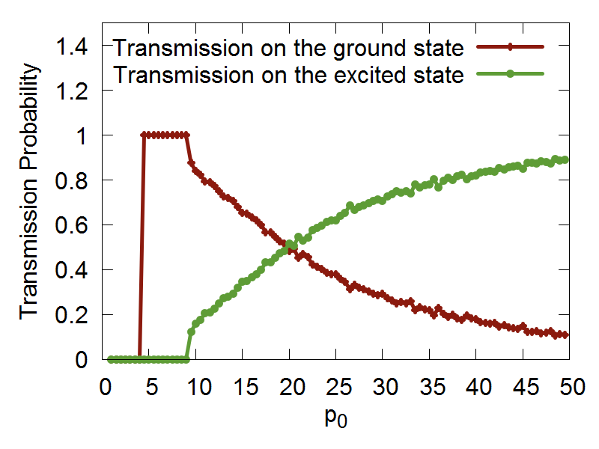
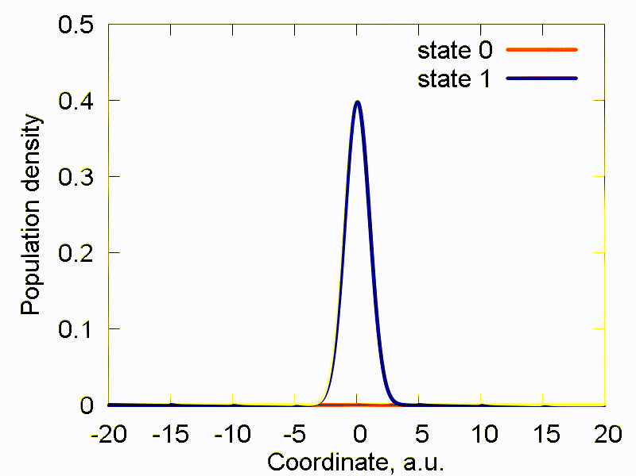
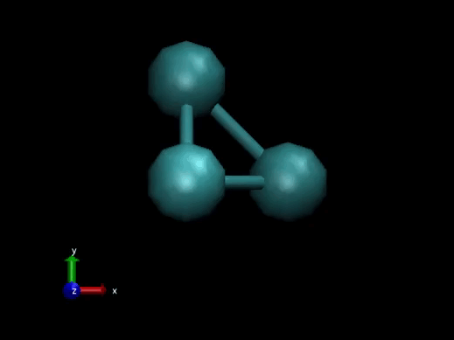
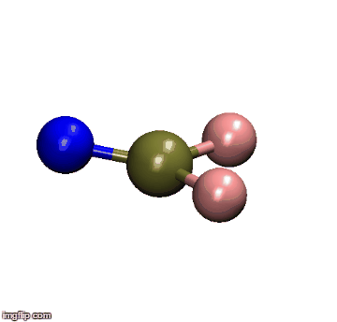
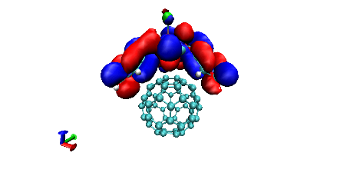
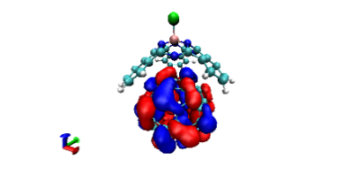
Libra History
Classical MD
Libra-X (with Drs. Ryoji Asahi, Kosuke Sato, Ekadashi Pradhan)
Sato, Pradhan, Asahi, Akimov PCCP 2018, 20, 25275
Pradhan, Sato, Akimov J. Phys.: Condens. Matter, 2018, 30, 484002
Interfaces with GAMESS, QE
Added back-reaction for QE
More modularization
Akimov, Prezhdo, JCTC, 2013, 9, 4959.
Akimov, Prezhdo, JCTC, 2014, 10, 789
Akimov JCC, 2016, 37, 1626
Ehrenfest & TSH
DVR
Back-reaction
Rigid body MD
Simplectic integrators for classical DOFs
Thermostats
Barostats
Force fields
ANN
Chemical object representation
Modularization and revision
DVR methods
Semiempirical Hamiltonians
Molecular integrals
Decoherence methods, TSH
Simplectic integrators for TDSE
TSH, Ehrenfest, stand-alone scripts
Decoherence methods
Model problems
Added HF and EHT to LCCCS
Interface with VASP, then QE
Pyxaid2 (with Prof. Wei Li)
Li, Zhou, Prezhdo, Akimov ACS Energy Lett, 2018, 3, 2159
SOC, multiple k-points, etc.
2007-2011
(LCCCS)
2011-2015
(Pyxaid)
2015/2016
(Libra)
2018
(Pyxaid2, Libra-X)

Slide 4
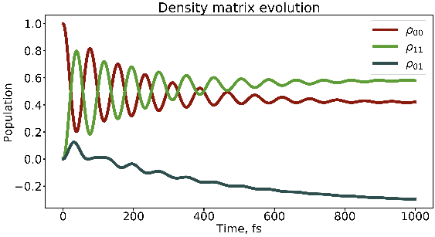
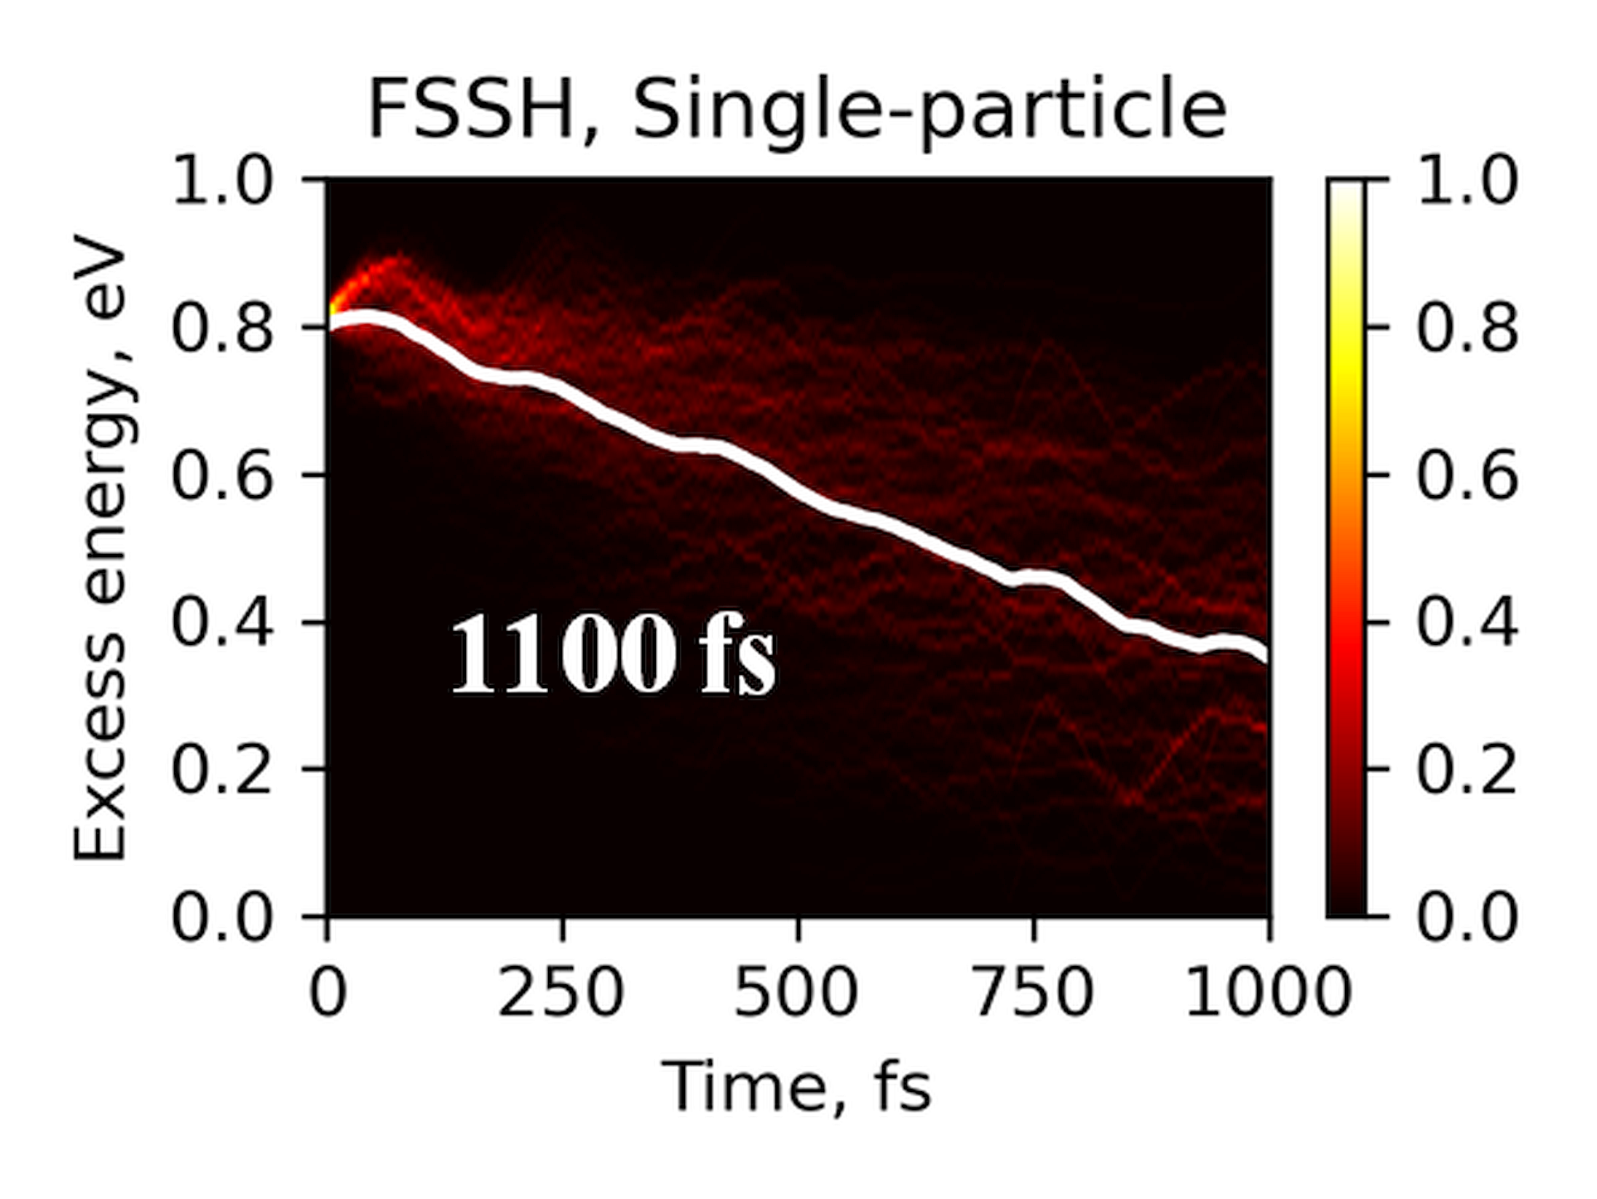
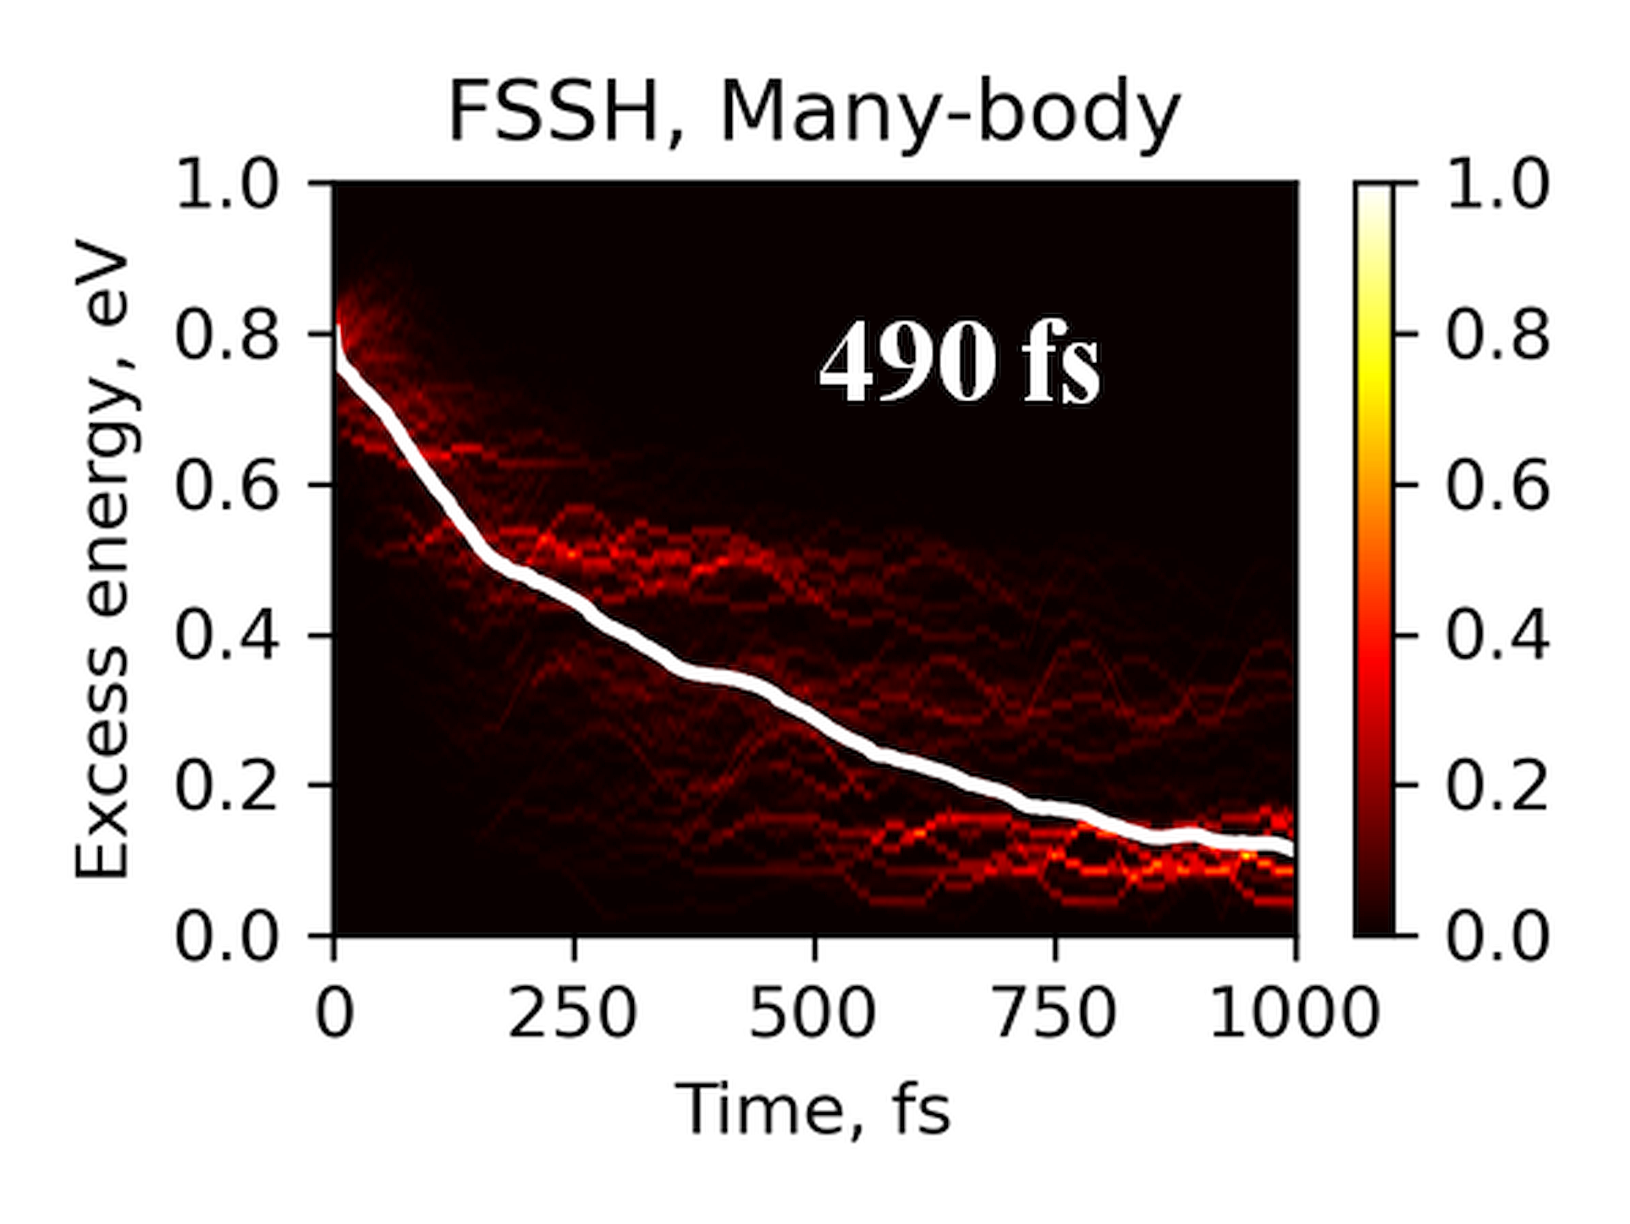
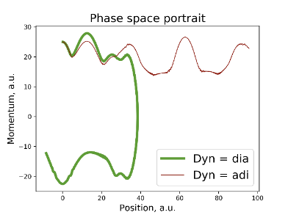
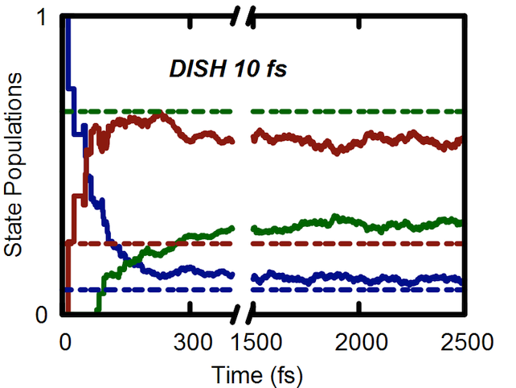
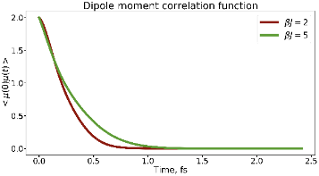
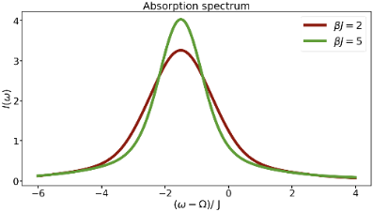
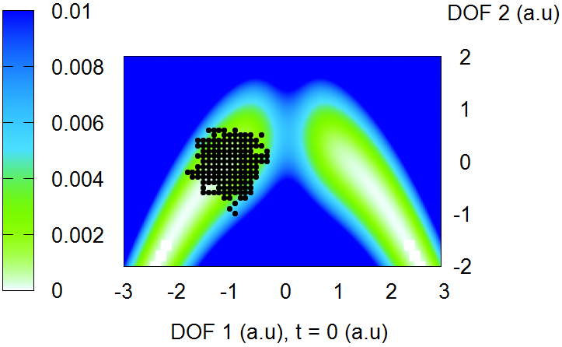
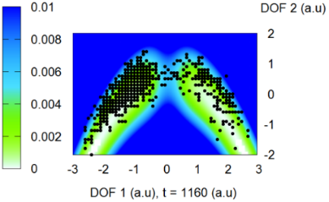
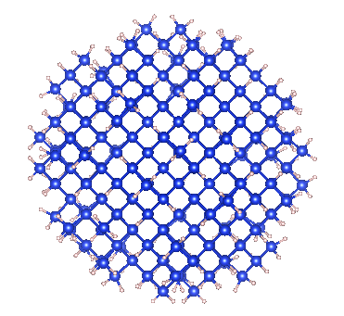
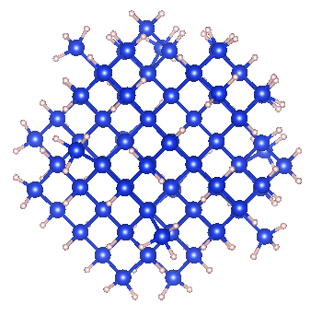
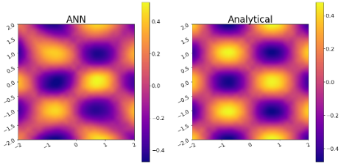
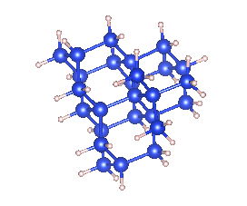
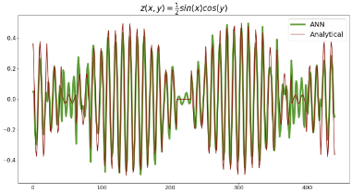
Libra History
Bastida’s Boltzmann-corrected Ehrenfest, mSDM
HEOM
Many-body NA-MD
Phase correction for NACs
Temen, Jain, Akimov Int. J. Quant. Chem., 2020, 120, e26373
Smith, B.; Shakiba, M.; AVA JCTC 2021, 17, 678
Smith, B.; Shakiba, M.; AVA JPCL 2021, 12, 2444
Akimov JPCL 2018 9, 6096-6102
Smith; Akimov JCP 2019, 151, 124107
Revised DISH, new workflows
Akimov JCP 2021, 155, 134106
Entangled trajectories
Smith, Akimov JCP 2018, 148, 144106
Belyaev-Lebedev LZ method
Machine Learning revised.
TD-ML approach
Smith, B.; Akimov, A. V JPCL 2020, 11, 1456-1465
Akimov JPCL 2021, 12, 12119
2018
2019
2020
2021

Slide 5
Libra Philosophy/Vision
modular
Maximize and simplify the re-use, OOP
linear algebra, integrals,
quantum and classical mechanics/dynamics,
nonadiabatic methods, surface hopping,
IO utilities, model preparation and analysis
versatile
“methodology discovery”
Use with model problems and atomistic simulations
Python – for convenience, C++ - for efficiency
(prototyping)
practical
Fully-functional tool that can be applied to real (atomistic) systems to study materials
user-friendly & documented
The code is convenient to users and they have plenty resources – examples and documentation
A platform to adopt the past and latest developments
The developers can understand and contribute to the code
community tool
Notes:
So that is what Libra is essentially about..
To give you a more practical idea of how these design principles are implemented, lets discuss several modules..

Slide 6
Libra Motivation
Many codes (Newton-X, SHARC, NEXMD, FIERBALL, JADE, MOLPRO, PYXAID, PYUNIXMD, …)
Black-box. Difficult to re-use to formulate other methods, etc.
Limited functionality (high focus, e.g. atomistic of special kind)
Many methods (FSSH, DISH, A-FSSH, QTAG, QTSH, etc.)
Not always available
Not always user-friendly (e.g. my experience with PYXAID prototype)
Not always portable/modular, lack of best coding standards, no version control, etc.
Limited consistency of different codes
Possible redundancies even in the same code

Slide 7
Libra Motivation
Adopt the best practices
Modularity (e.g. PySCF, Psi4NumPy, PyQuante, HORTON)
Language standards (Python, C++ vs. Fortran? Hybrid programming)
Testing & Documentations (pytest, unittest, Doxygen/Sphinx)
User/developer training (Workshops, Summer/Winter schools)
Focus on the community
Every group has expertise in their field – rely on that
Community contributions – PR on GitHub
Use version control and collaborative workflows via GitHub, Issues
Frequent communication and close collaboration e.g. via Slack

Slide 8
Community Tool: Code Contributions/Integration
Amber Jain – Hierarchical Equations of Motion (HEOM)
src/dyn/heom
https://github.com/amber-jain-group-iitb/heom_amber
Xiang Sun – (Non)-equilibrium Fermi Golden Rule (FGR)
src/fgr
https://github.com/tsiangsun/FGR
Nandini Ananth – Initial value representation (IVR)
src/ivr
https://github.com/AnanthGroup/SC-IVR-Code-Package
Sophya Garaschchuk – quantum trajectory guided Gaussians (QTAG)
src/libra_py/dynamics/qtag
Craig Martens – quantum trajectory surface hopping (QTSH)
in progress
… and more

Slide 9
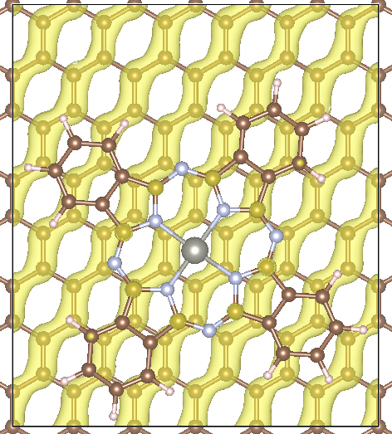
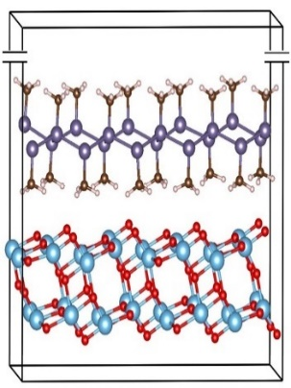
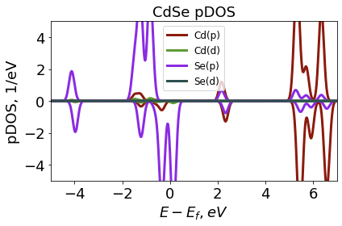
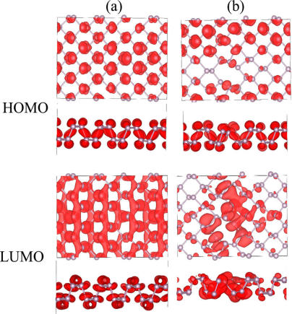
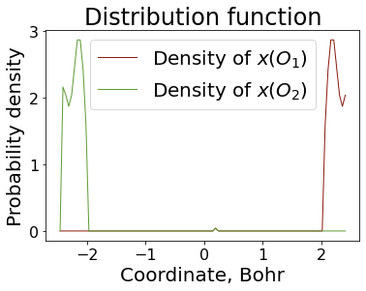
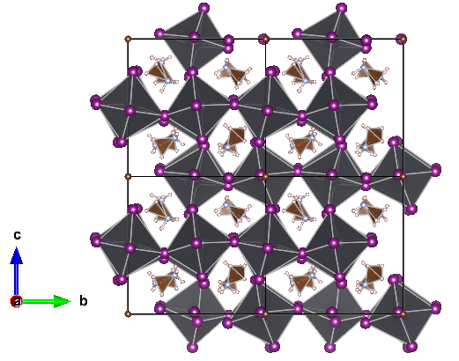
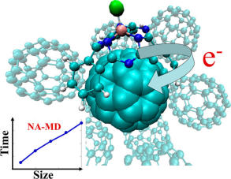
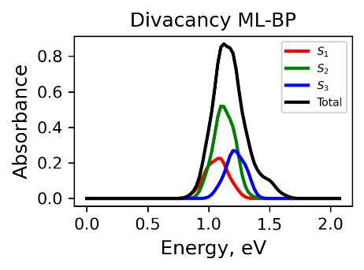
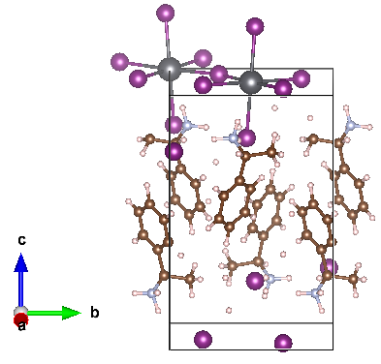
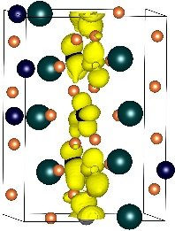
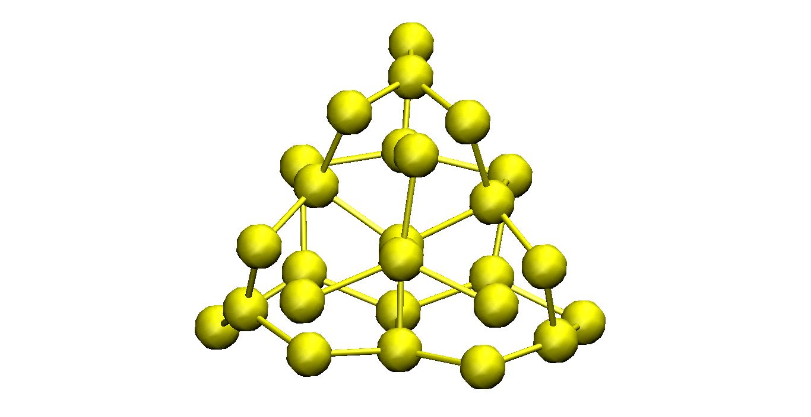
Practical: Libra in Materials Research
2D systems
2D heterojunctions
Auxiliary Analysis Tools
Long el al. JPCL 2016, 7, 653.
Nijamudheen, A.; AVA JPCC, 2017, 121, 6520
Perovskites
Quantum Dots & Molecules
Organic heterojunctions
Nijamudheen, A.; AVA JPCL 2018, 9, 248
Lin, Y.; AVA JPCA. 2016, 120, 9028
Sato et al. PCCP, 2018, 20, 25275.
Pradhan et al. JPCM, 2018, 30, 484002

Slide 10


C++/Python Interoperability
C++ layer
Python layer
User-Customized & Library
Python functions
Call by C++
Eigen 3
libra_py
Prototype and
Test (Discover)
Translate code
Use in C++ codes
Use in Python codes

Slide 11
Modularity: API Diversity
The goal is to suite the needs of the users of various levels
Find a balance between simplicity and flexibility
Developer/Efficiency
double gaussian_overlap( AO* AOa, AO* AOb,int is_normalize, int is_derivs, VECTOR& dIdA, VECTOR& dIdB, vector<double*>& auxd,int n_aux);
double gaussian_overlap( AO* AOa, AO* AOb,int is_normalize, int is_derivs, VECTOR& dIdA, VECTOR& dIdB );
double gaussian_overlap(AO* AOa, AO* AOb,int is_normalize);
double gaussian_overlap(AO* AOa, AO* AOb);
User/Convenience

Slide 12
Example
Computing kinetic energy between Gaussians
g1 = PrimitiveG()
g2 = PrimitiveG()
g1.init(n1,m1,k1, a1, VECTOR(x1, y1, z1))
g2.init(n2,m2,k2, a2, VECTOR(x2, y2, z1))
kin = kinetic_integral(g1,g2)
Benchmarked against PyQuante
p1 = PyQuante.PGBF.PGBF(a1,(R1.x,R1.y,R1.z),(n1,m1,k1))
p2 = PyQuante.PGBF.PGBF(a2,(R2.x,R2.y,R2.z),(n2,m2,k2))
val_ref = p1.kinetic(p2)

Slide 13

Passing Python functions
C++
Python
Models
Implementation
Interface

Slide 14
How it works with Sampling
vector<MATRIX> metropolis_gau
(Random& rnd, bp::object target_distribution,
MATRIX& dof, bp::object distribution_params,
int sample_size, int start_sampling, double gau_var){
Metropolis Algorithm
double p_old =
bp::extract<double>( target_distribution(s_old, distribution_params) );
…
}
def test():
q = MATRIX(ndof, 1)
output = metropolis_gau( piab, q, params, ...)
User calls the sampling
Output
def piab(q, params):
User defines the
probability density
C++
Python

Slide 15
Example
q = MATRIX(1,1); q.set(0, 0.5)
params = {"k":1.0, "m":2000.0, "states":[0], "coeffs":[1.0]}
Nsamp = 1000000; Nstart = 50000
sampling = metropolis_gau(rnd, HO_sup, q, params, Nsamp,Nstart, 0.05)
bin(sampling, -1.5, 2.0, 0.01, 0, 0, "_distrib-1.txt")
User defines how to
run the MC sampling
def HO_sup(q, params):
k = params["k"]; m = params["m"];
states = params["states"]; coeffs = params["coeffs"]
x = q.get(0)
sz = len(states)
p = 0.0
for n in xrange(sz):
p = p + coeffs[n] * ket_n(x, states[n], k, m)
p = p * p
return p
User defines what
probability distribution
function is to be sampled
The dynamical algorithm is in C++, but…
Don’t need to implement the model in C++

Slide 16
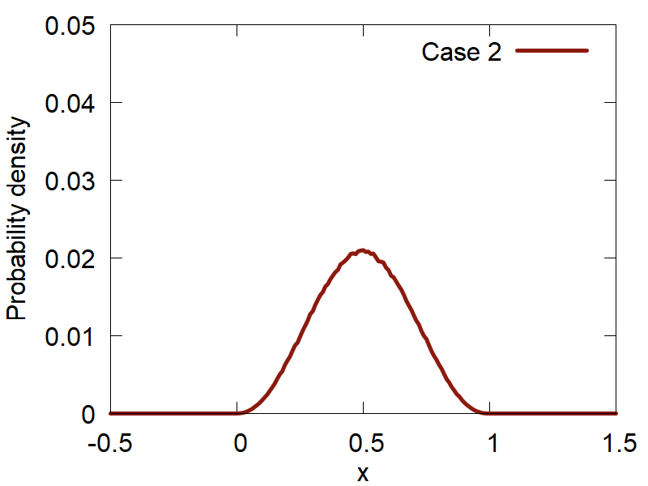
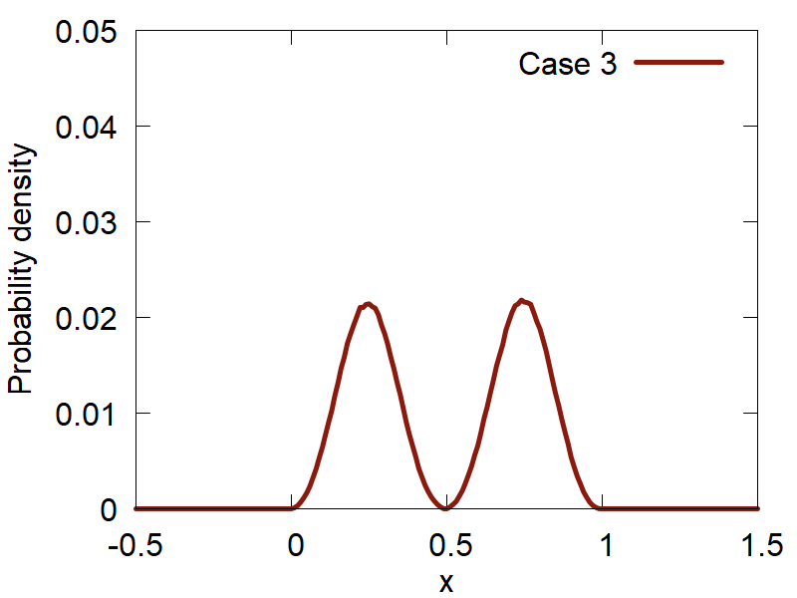
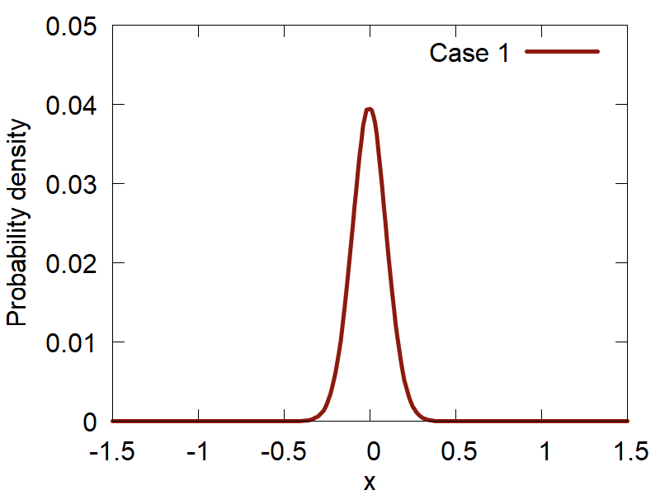
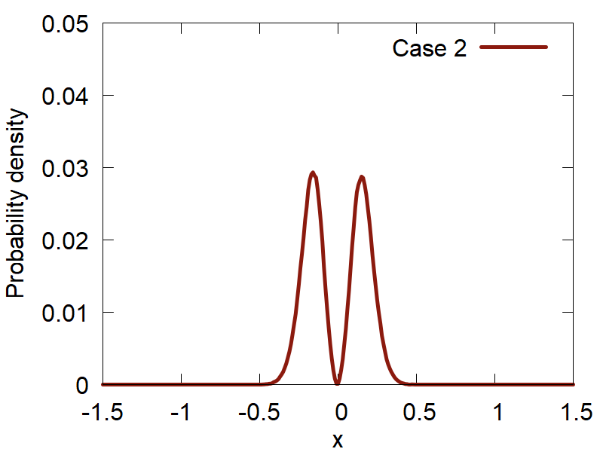
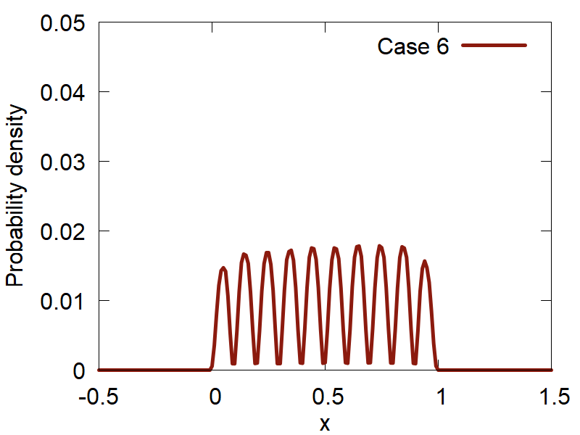
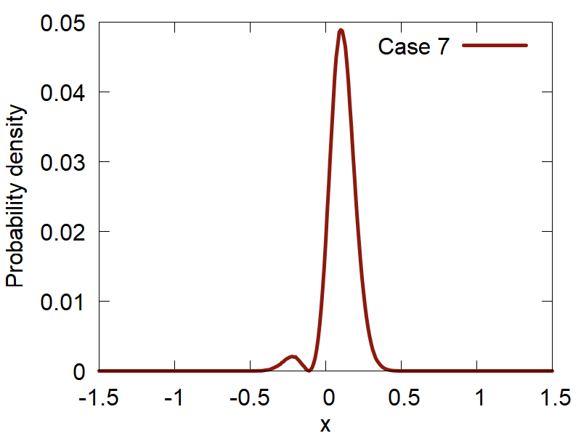
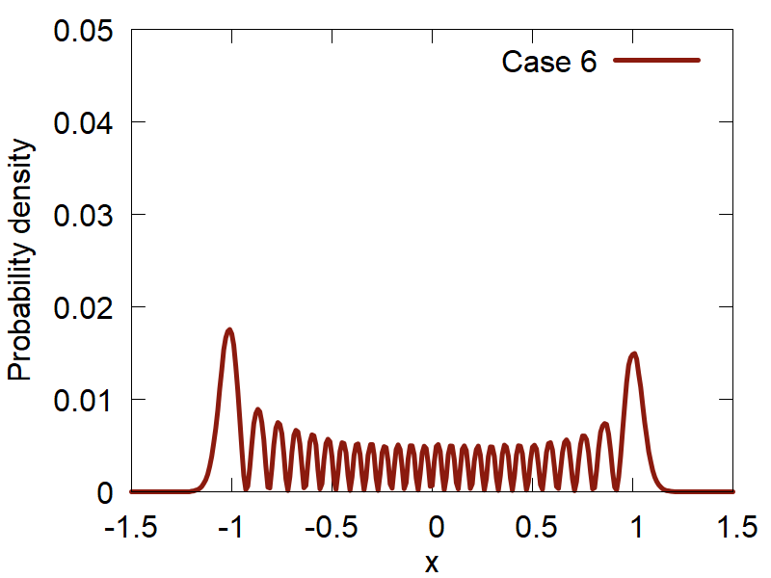
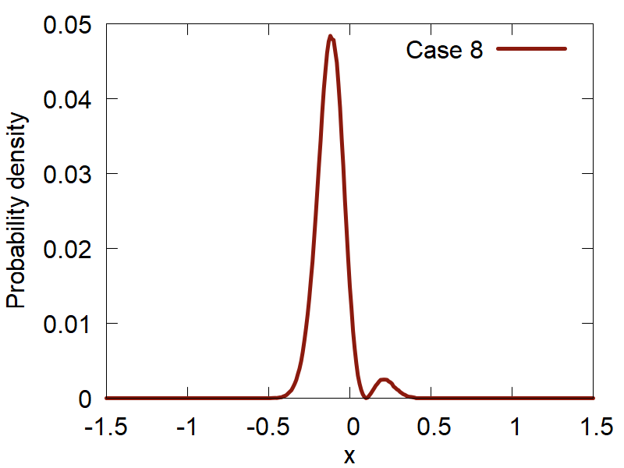
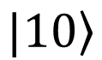
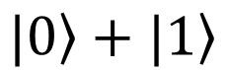
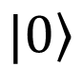
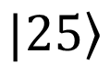
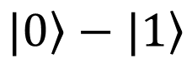
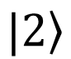
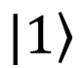
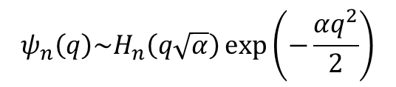


Initial Conditions: Metropolis Sampling
Particle in a box
Harmonic oscillator
$$ψ_{n}\left(q\right)\sim \sin\left(\frac{πnq}{L}\right)$$
$$ψ_{n}\left(q\right)\sim H_{n}\left(q\sqrt{α}\right)\exp\left(−\frac{αq^{2}}{2}\right)$$
$$\left.|1\right\rangle$$
$$\left.|2\right\rangle$$
$$\left.|1\right\rangle$$
$$\left.|0\right\rangle$$
$$\left.|10\right\rangle$$
$$\left.|0\right\rangle +\left.|1\right\rangle$$
$$\left.|25\right\rangle$$
$$\left.|0\right\rangle −\left.|1\right\rangle$$

Slide 17
Why Contribute?
Make your methods broadly available (mutually advertise)
Be listed on the developers/contributors lists, get credentials, get citations
Make your methods compatible with other methods, enable easier interfacing – this facilitates new methods developments
Take advantage of other methods/functions/data types available in the same code – learn once then swim
Take advantage of improvements of other parts of the code
Mutually ensure best standards and facilitate bug discovery/testing

Slide 18

How to Contribute?
https://github.com/amber-jain-group-iitb/heom_amber
Before:
hard-coded inputs (recompile for all parameters)
Fortran into executable
After:
General-purpose code, any inputs
Python/C++, integrate with the plotting scripts, etc.
create a pull-request
open an issue
start a discussion (haven’t tried yet)

